Slide 1
Introduction to Databases

Slide 2
What is a Database?

Slide 3
“
A database is an organized collection of data. The data is typically organized to model relevant aspects of reality, in a way that supports processes requiring this information.
”
Source: Wikipedia
(Emphasis Mine)

Slide 4
Types of Database

Slide 5
SQL (Relational)
Highly Structured Data
Using Tables, Columns and Rows
One or more relationships exist within the data
Constraints
Primary Keys (unique row identifier)
Unique Keys (one or more columns must have unique values, either individually or as a group)
Foreign Keys (column value must be derived from a column value in another table)
Indexes
A lookup for rows based on values of one or multiple columns

Slide 6
NoSQL (Document/Key-Value/Graph)
Sometimes called “Not Only SQL” because some NoSQL DBs have a SQL-like query language
Not always non-relational
Always unstructured
Intended to provide higher scalability and higher availability
Looser consistency models

Slide 7
NoSQL (Document/Key-Value/Graph)
NoSQL is non-relational
Document Stores
Centers around the concept of a document, and its related metadata
Collections of documents
Hierarchies of documents
Examples: Couchbase Server, CouchDB, MongoDB, Amazon SimpleDB, Oracle NoSQL DB
Key-Value Stores
Data stored and accessible directly by a unique key
Examples: Memcache, MongoDB, Couchbase Server, Cassandra, Riak, Amazon DynamoDB, Redis, Oracle NoSQL DB

Slide 8
NoSQL (Document/Key-Value/Graph)
NoSQL is relational (say what?!)
Graph Databases
All data is related to N other data
Relationships are in the data, not indexes
Examples: Neo4J, OQGraph for MySQL
Example Implementation: Facebook’s Graph API

Slide 9
A Note on MySQL
MySQL supports multiple drivers (called engines) for its tables.
These engine provide different features.
The two most common are InnoDB (default since MySQL 5.5) and MyISAM (previously the default).
InnoDB has far more features, and is recommended for almost all situations
We will assume InnoDB for all MySQL examples

Slide 10
Relational Concepts
Schema
Tables
Indexes
Relationships
Stored Procedures
Triggers

Slide 11
Name | What
integer | exact whole numbers
decimal | exact decimal numbers (fixed length)
text | text
blob | binary data
NULL | Null values
Notes:
- Make sure to explain NULL fully

Slide 12
Users Table
Unique Identifier
Username
Password
Email Address
Name or First Name/Last Name
Column Names
Column Types
Consider:

Slide 13
User Table
User
id | integer
username | text
password | text
email | text
first_name | text
last_name | text

Slide 14
Exercise 1:
Create a user table

Slide 15
User Table
CREATE TABLE
User
id | integer
username | text
password | text
email | text
first_name | text
last_name | text
(
,
,
,
,
,
);

Slide 16
Users Table (Schema)
CREATE TABLE user (
id INTEGER,
username TEXT,
password TEXT,
email TEXT,
first_name TEXT,
last_name TEXT
);

Slide 17
SQL: Four Main Queries
INSERT — Create Data
UPDATE — Update Existing Data
SELECT — Fetch Data
DELETE — Delete Data

Slide 18
CRUD
C | reate | INSERT
R | etrieve | SELECT
U | pdate | UPDATE
D | elete | DELETE

Slide 19
Conditions
Used with:
SELECT
UPDATE
DELETE
JOINs
Preceded by the WHERE, ON, USING, or HAVING keyword

Slide 20
Operators
Operator
= | Equality
<>, != | Inequality
< | Less Than
<= | Less Than or Equal To
> | Greater Than
>= | Greater Than or Equal To
IS NULL | NULL Equality
IS NOT NULL | NULL Inequality
AND | Boolean AND
OR | Boolean OR
BETWEEN | Range Equality

Slide 21
INSERT
INSERT INTO table name (
list,
of,
columns
) VALUES (
"list",
"of",
"values"
);

Slide 22
Exercise 2:
Insert a user

Slide 23
INSERT
INSERT INTO user (
id,
username,
password,
email,
first_name,
last_name
) VALUES (
1,
"dshafik",
"$2y$10$Ol/KS4/Bhs5ENUh7OpIDL.Gs1SIWDG.rPaBkPAjjQ2UTITI60YDmG",
"davey@engineyard.com",
"Davey",
"Shafik"
);

Slide 24
UPDATE
UPDATE
table name
SET
column = "some",
name = "value"
WHERE
some condition;

Slide 25
WARNING:
Don’t forget your conditions!
Otherwise you update every row in the table!
Additionally, consider using the safe-updates option

Slide 26
Exercise 3:
Update a user

Slide 27
UPDATE
UPDATE
user
SET
username = "davey",
email = "davey@engineyard.com"
WHERE
id = 1;

Slide 28
SELECT
SELECT
list, of, columns
FROM
table
WHERE
column = "some"
AND name = "value"
OR other_column = "other value"
ORDER BY
some ASC, columns DESC
LIMIT
start, offset;

Slide 29
Exercise 4:
Select one user
with a given username and password

Slide 30
SELECT
SELECT
*
FROM
user
WHERE
username = "davey"
AND password = "$2y$10$Ol..."
LIMIT
1;

Slide 31
Exercise 5:
Select the first 10 users

Slide 32
SELECT
SELECT
first_name, last_name, email
FROM
user
ORDER BY
first_name, last_name
LIMIT
0, 10;

Slide 33
Exercise 6:
Select the second 10 users

Slide 34
SELECT
SELECT
first_name, last_name, email
FROM
user
ORDER BY
first_name, last_name
LIMIT
10, 10;

Slide 35
DELETE
DELETE FROM
table
WHERE
column = "some"
AND name = "value"
OR other_column = "other value"
ORDER BY
some ASC, columns DESC
LIMIT
number;

Slide 36
DELETE
DELETE FROM
user;

Slide 37


Slide 38
Exercise 7:
Delete one user

Slide 39
DELETE
DELETE FROM
user
WHERE
id = 1;

Slide 40
Constraints: Users Table
IDs should be unique
Usernames should be unique
Passwords should not be unique
Email Address should be unique
First Name should not be unique
Last Name should not be unique
All column should not be null

Slide 41
Constraints: Users Table
Users |  | Constraints
id | integer | not null, unique
username | text | not null, unique
password | text | not null
email | text | not null, unique
first_name | text | not null
last_name | text | not null

Slide 42
Constraints: Users Table Schema
DROP TABLE
user;
CREATE TABLE user (
id INTEGER NOT NULL UNIQUE,
username TEXT NOT NULL UNIQUE,
password TEXT NOT NULL,
email TEXT NOT NULL UNIQUE,
first_name TEXT NOT NULL,
last_name TEXT NOT NULL
);
Notes:
- NOT NULL option
- Have to use UNIQUE INDEX to get a UNIQUE constraint

Slide 43
Users Table: AutoIncrement
ID should be autoincrement
ID should be the primary key

Slide 44
Features: Users Table Schema
CREATE TABLE user (
id INTEGER PRIMARY KEY AUTOINCREMENT
NOT NULL,
username TEXT NOT NULL UNIQUE,
password TEXT NOT NULL,
email TEXT NOT NULL UNIQUE,
first_name TEXT NOT NULL,
last_name TEXT NOT NULL
);

Slide 45
Entry Table
Unique identifier
Title
Article
Must link to the user table
Consider:

Slide 46
Entry Table
Entry
id | integer | primary key, autoincrement
user_id | integer | not null
title | text | not null
article | text | not null

Slide 47
Entry Table Schema
CREATE TABLE entry (
id INTEGER NOT NULL PRIMARY KEY
AUTOINCREMENT,
user_id INTEGER NOT NULL,
title TEXT NOT NULL,
article TEXT NULL
);

Slide 48
INSERT
INSERT INTO entry (
user_id,
title,
entry
) VALUES (
1,
"How to Write SQL",
"Writing SQL in PHP is fun and easy!"
);

Slide 49
JOINs
Used to JOIN multiple tables
INNER JOIN
LEFT or RIGHT OUTER JOIN
See: A Visual Explanation of SQL Joins
SELECT
*
FROM
table_1
INNER JOIN
table_2 ON (condition);

Slide 50

INNER JOIN
Users
Entries
Users with Entries

Slide 51

LEFT OUTER JOIN
Users
Entries
Users without Entries
Users with Entries

Slide 52
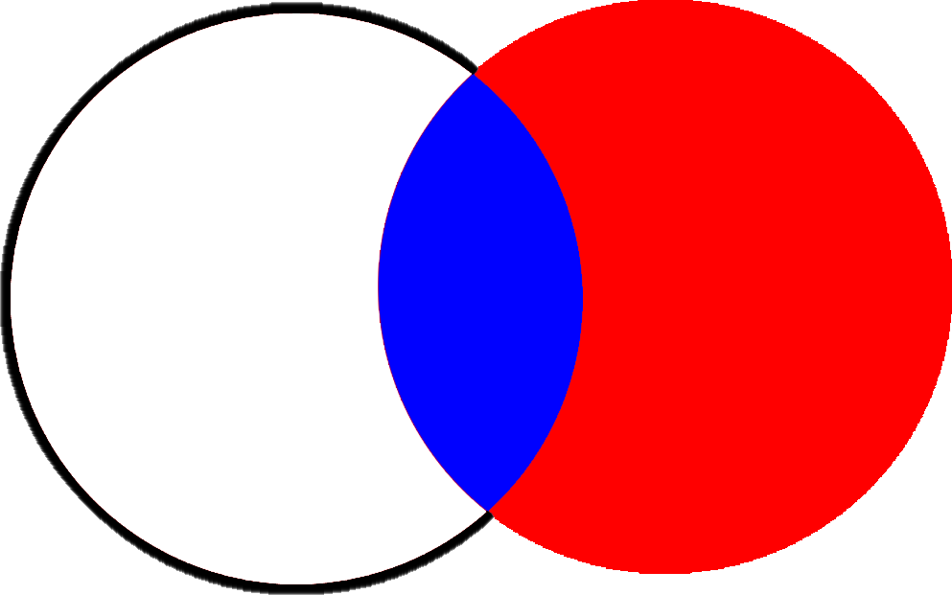
RIGHT OUTER JOIN
Users
Entries
Entries by Deleted Users
Entries with Users (Authors)

Slide 53
Exercise 8:
Select all entries that have users

Slide 54
SELECT... INNER JOIN
SELECT
*
FROM
entry
INNER JOIN
user ON (entry.user_id = user.id);

Slide 55
Exercise 9:
Select all entries, with users where available

Slide 56
SELECT... LEFT OUTER JOIN
SELECT
*
FROM
entry
LEFT OUTER JOIN
user ON (entry.user_id = users.id);

Slide 57
Connecting to Databases
PDO
SQLite
MySQL
PostgreSQL
MSSQL
Oracle
ODBC and DB2
Firebird
DSN — Data Source Name
Driver Name
Hostname & Port or Unix Socket
Username
Password
Database Name
Charset
Connecting
new PDO()

Slide 58
Connecting to SQLite
<?php
try {
$pdo = new \PDO("sqlite:/path/to/db.sqlite");
} catch (\PDOException $ex) {
error_log($ex->getMessage());
}
?>

Slide 59
Executing Queries
try {
$pdo = new \PDO(…);
$query = $pdo -> prepare(
"SELECT * FROM user WHERE id = :id"
);
$conditions = array(
':id' => 1
);
$result = $query->execute($conditions);
} catch (\PDOException $ex) {
error_log($ex->getMessage());
}

Slide 60
Handling Results
<?php
$result = $query->execute($conditions);
if ($result) { echo "Results Found: " . $query->rowCount();
while ($row = $query->fetch()) {
echo "<a href='/edit/" . $row[‘id'] . "'>"
. $row[‘first_name'] . ' '
. $row['last_name'] . '</a>';
}
}
?>

Slide 61
Handling Results as Objects
<?php
$result = $query->execute($conditions);
if ($result) {
echo "Results Found: " . $query->rowCount();
while ($row = $query->fetchObject()) {
echo "<a href='/edit/" . $row->id . "'>"
. $row->first_name . ' '
. $row->last_name . '</a>';
}
}
?>

Slide 62
Handling Results as Custom Objects
class User {
function getName() {
return $this->first_name
. ' ' . $this->last_name;
}
}
if ($result) {
echo "Results Found: " . $query->rowCount();
while ($row = $query->fetchObject("User")) {
echo "<a href='/edit/" . $row->id . "'>"
. $row->getName() . '</a>';
}
}

